Slide 1
G2M: Case Study
Market Analysis
Data Glacier: Virtual Internship
Mahaalakshmi Mukkamala

Slide 2
Case study details:
Purpose: XYZ is a private equity firm that wants to invest in in cab industry. As it is believed that the cab industry in the United States of America has had remarkable growth over the past few years, XYZ plans to invest in the industry.
Objective: XYZ is looking for analysis of the market (G2M), to understand more about the market before making an investment. Providing subsequent analysis over the markets and its current competition is necessary before making investments.
The analysis is divided into the following parts:
Understanding the data, and cleaning it.
Analysis on Area.
Analysis on company.
Analysis on company.

Slide 3
Understanding data, and cleaning it.
Data Exploration:
For the purpose of analysis, the following datasets were provided:
Transaction_ID.csv
city.csv
cab_data.csv
Customer_ID.csv
None of the fields in the files had any missing values, and did not have to be filled.
The outliers present could not be removed and factors such as Kilometers are present.
Profit generated for companies was calculated only taking features: Price Charged, and Cost of Trip. Rest of the features are kept constant.
City.csv was not merged in the main dataset as the file in itself is self sufficient.

Slide 4
Main data:
The main data was by merging the following files:
Customer_ID.csv
Transaction_ID.csv
Cab_data.csv
The common features were found, and merged.
The analysis of various factors are considered using the main data, and city data.

Slide 5
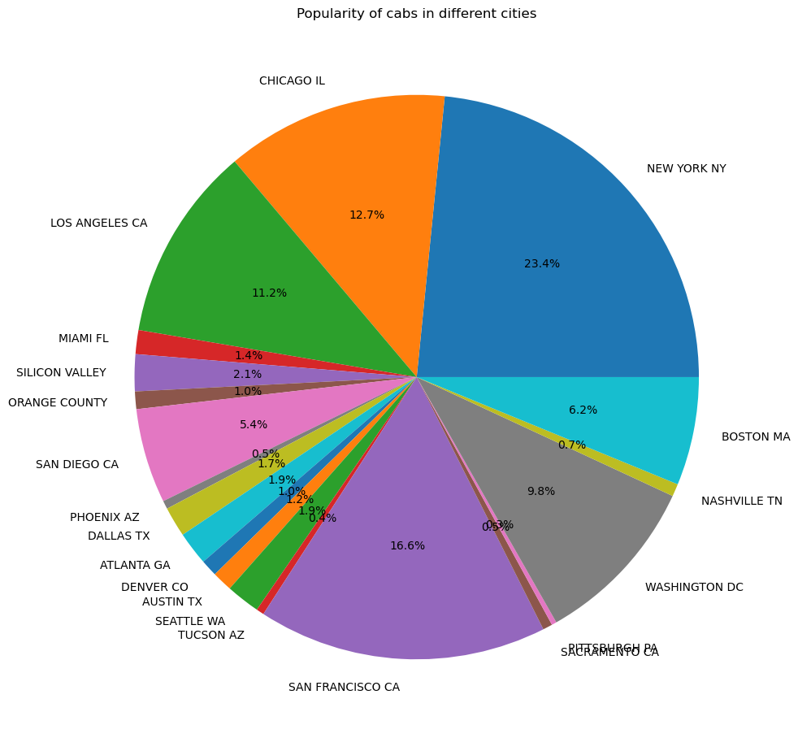
Analysis on Area
New York has the highest percentage of cab users.
San Francisco has the second largest user base of cab users on USA.

Slide 6
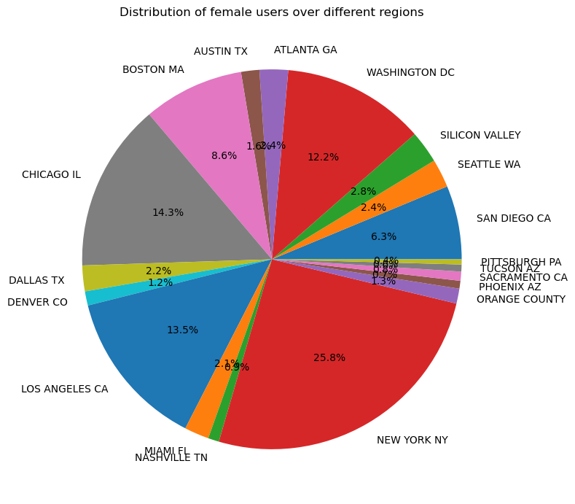
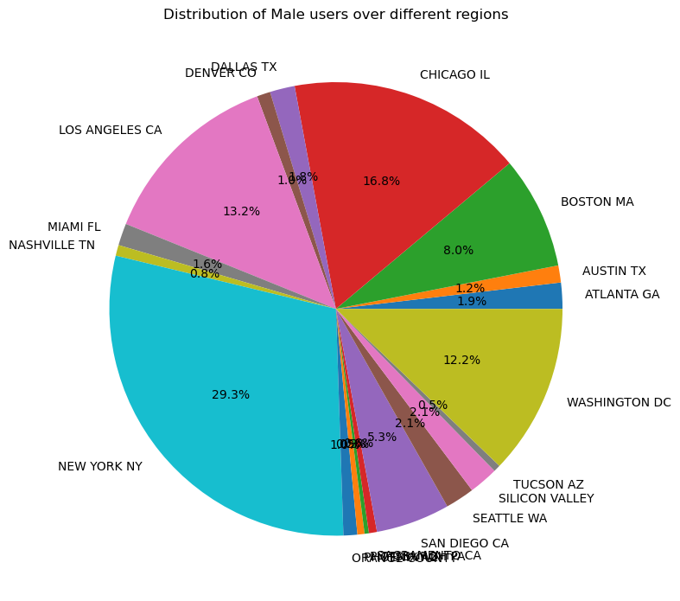
New York has the most female and male cab users in USA.
Chicago has the second highest male and female cab users in USA.

Slide 7
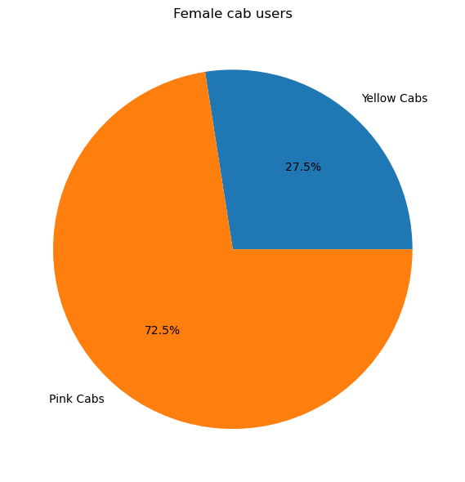
Analysis on Customers:
Pink cabs have a higher rate of female users than yellow cabs.

Slide 8
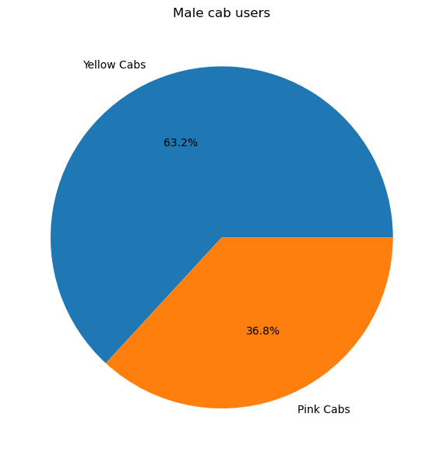
Yellow cabs have a higher rate of male users than yellow cabs.

Slide 9
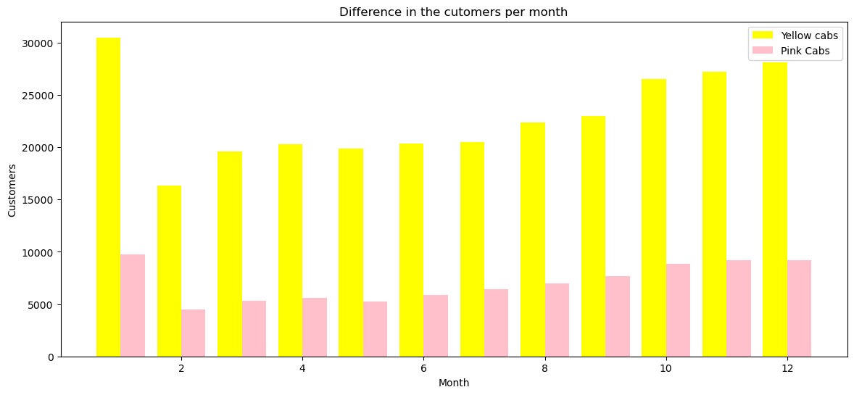
The customers each month is not constant.
Yellow cabs have a higher customer base than compared to pink cabs.

Slide 10
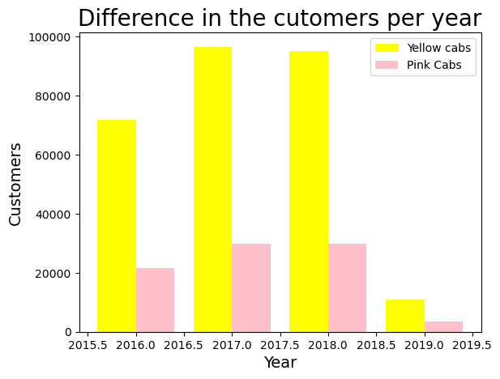
The customers each year is not constant.
On an overall, yellow cabs have a larger customer base.

Slide 11
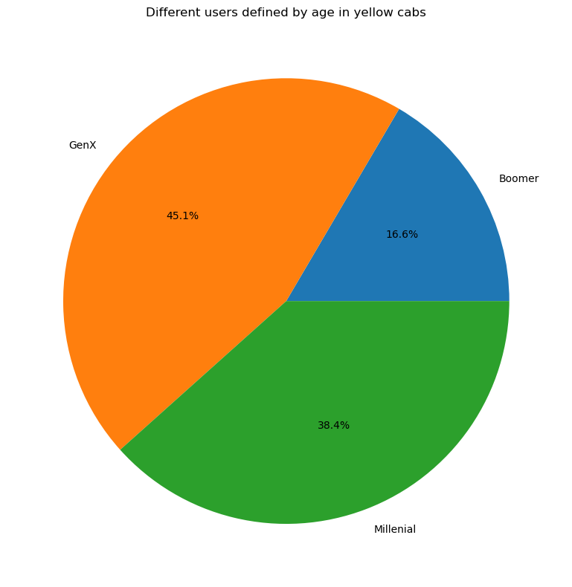
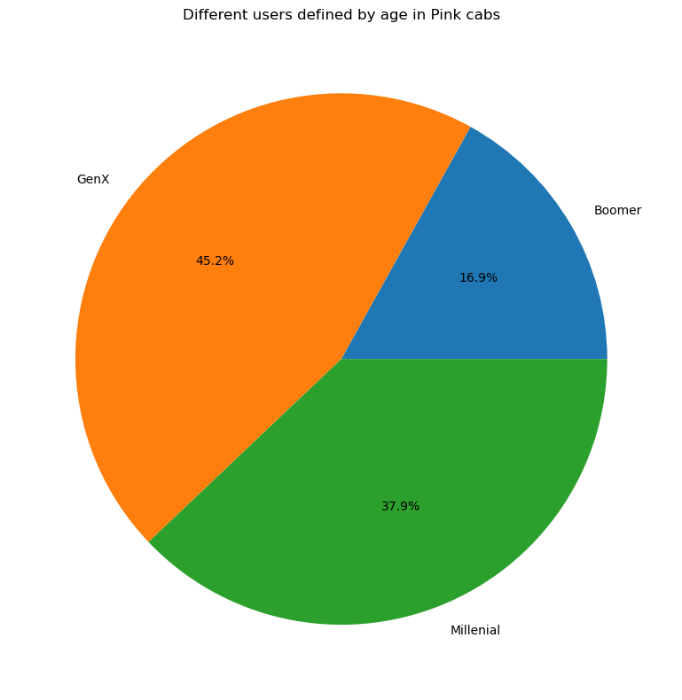
Genx: 18 - 31
Millennial: 32-50
Boomers:
51-65
GenX age group use the cab the most in both yellow and pink cabs.
Both yellow and pink cabs have very similar percentages in age gaps, it can be said that for both the companies, the age group of the people who use cabs are the same.

Slide 12
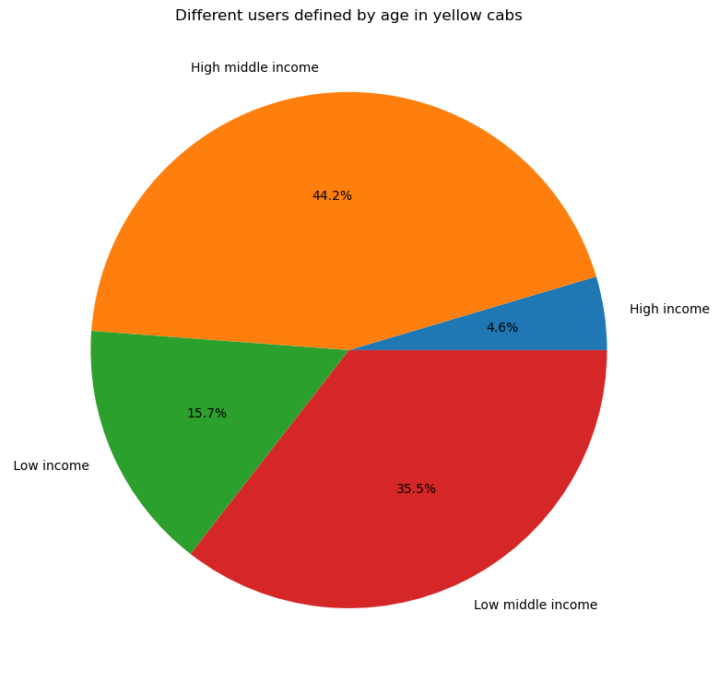
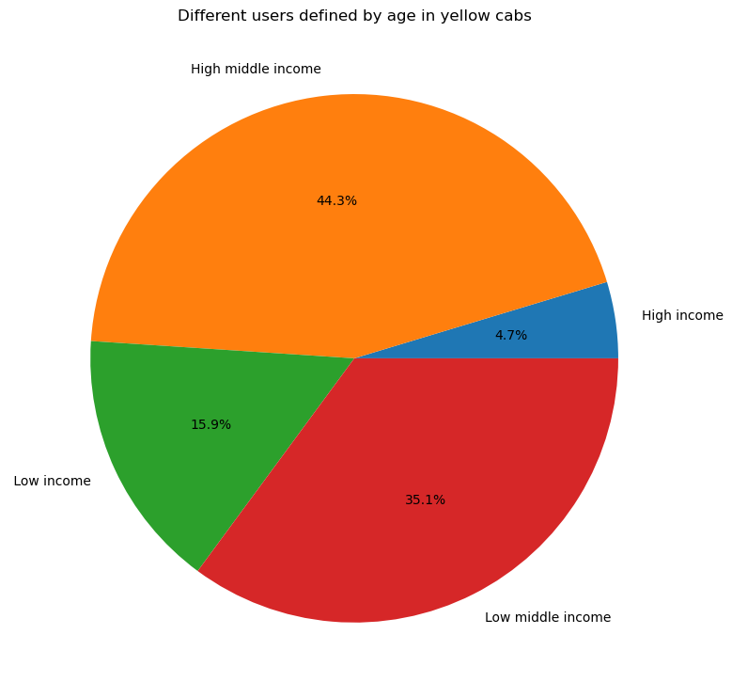
Low: 2k-6k
Low middle: 6k-15k
High middle: 15k-30k
High: 30k-35k
Users with higher middle income use the cab the most in both yellow and pink cabs.
Middle class income: High and Low have the highest percentage of users in the cab industry.

Slide 13
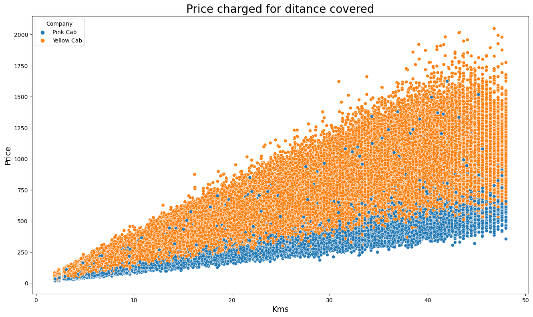
Yellow cabs charge more price than pink cabs.
Yellow cabs also charge higher as the kilometers increase.

Slide 14
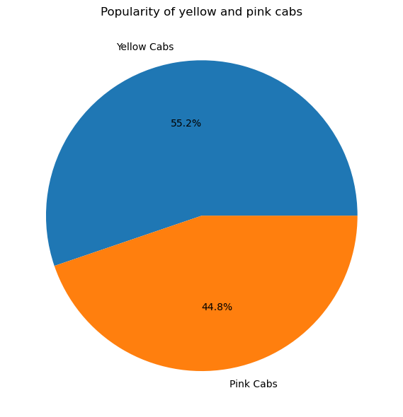
Taking only unique users, yellow cabs have a higher user base than that of pink cabs.

Slide 15
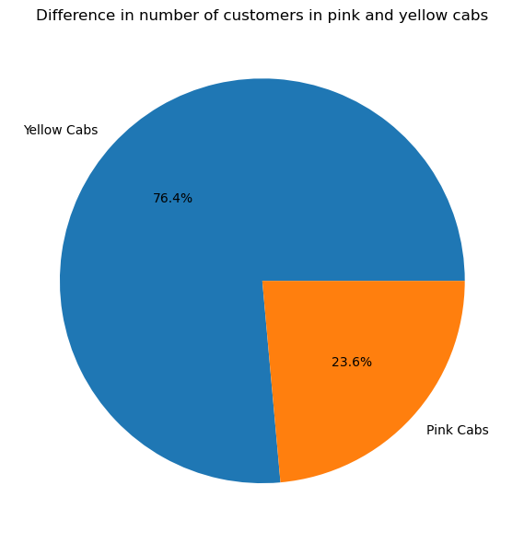
After considering repeated users, Yellow cabs have a more loyal fan base than pink cabs. ​​

Slide 16
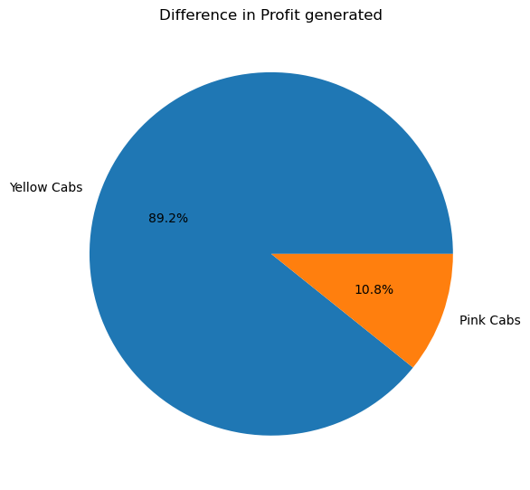
Yellow cabs have a higher profit percentage compared to pink cabs.

Slide 17

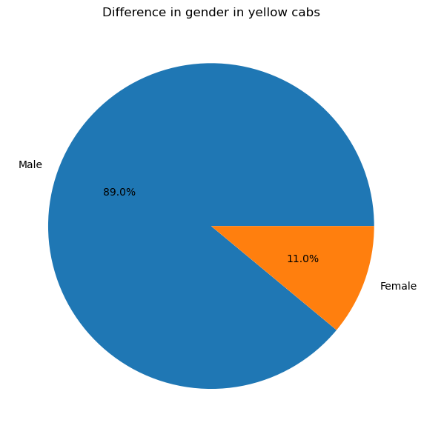
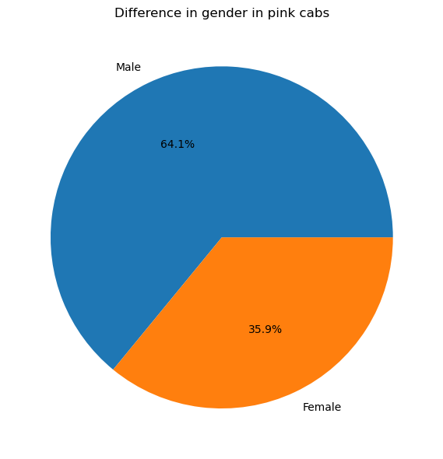
Both the companies have higher male users than that of female users

Slide 18
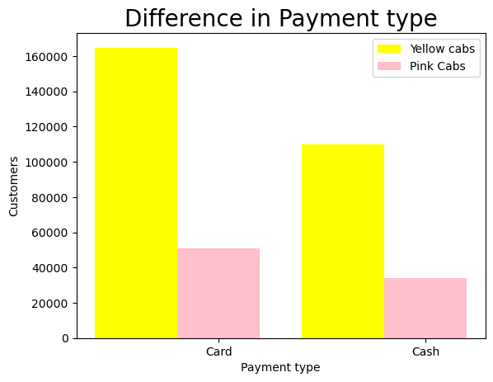
There are more cab users, than cash users.
The difference in card to cash payment in percentages is the same in both the companies

Slide 19
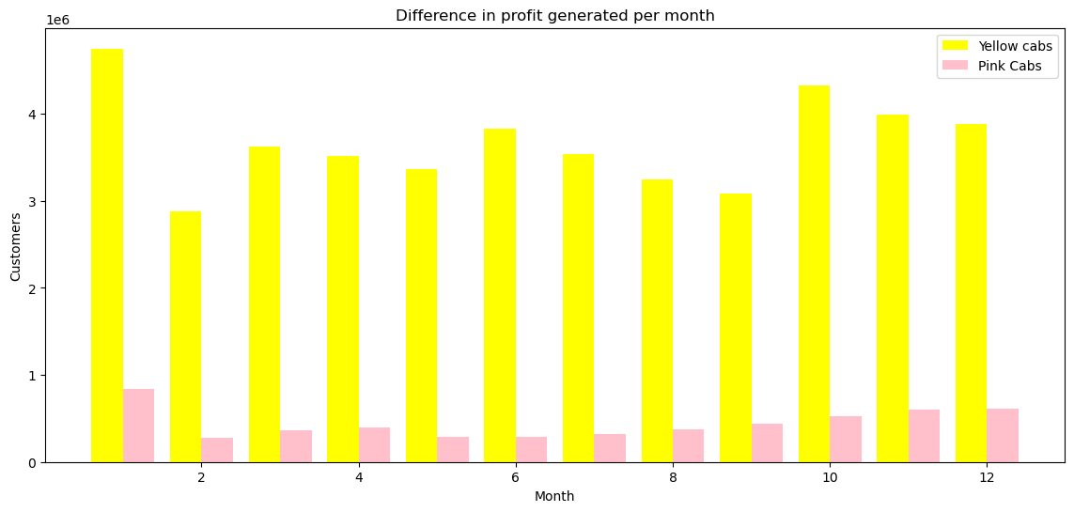
Yellow cabs have a higher profit percentage compared to pink cabs.
Profit generated each month is not constant and changes with time.

Slide 20
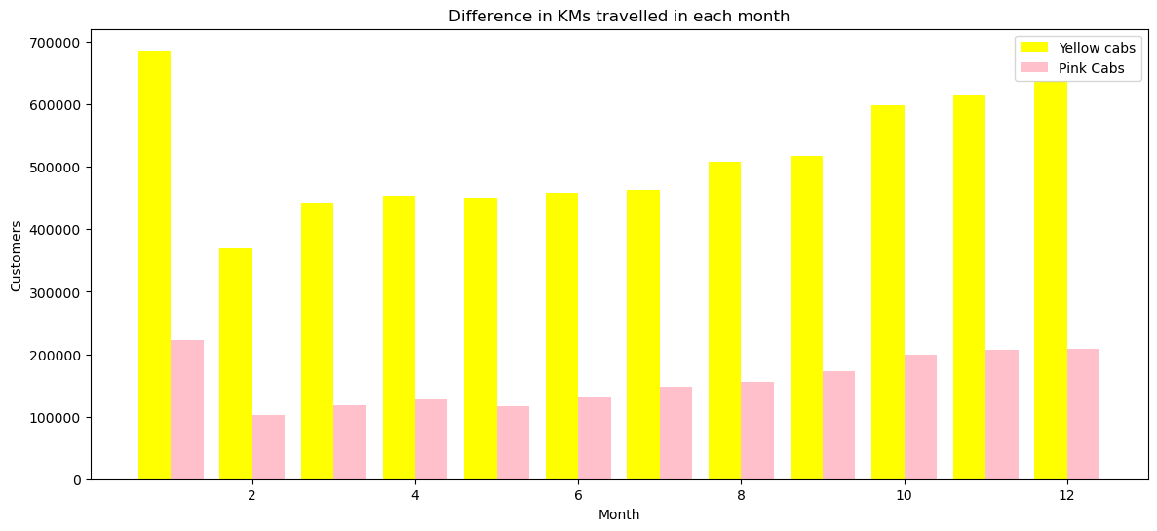
Yellow cabs have travelled more in KMs than compared to pink cabs every month.

Slide 21
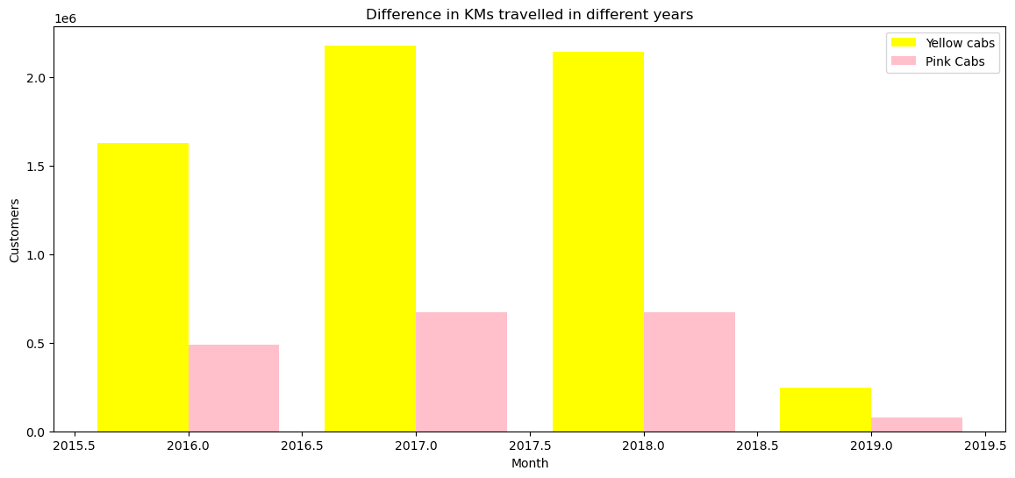
Yellow cabs have travelled more in KMs than compared to pink cabs every year

Slide 22
Recommendations:
Age groups of GenX have a higher user base in both of the companies, hence should be targeted more.
Middle class income has the highest user base in both the companies.
New York has the highest number of cab users.
Yellow cabs have a bigger profit range than pink cabs.
Male users have a higher customer base.
Pink cabs have higher female customers than yellow cabs.
Users pay by card more in both pink and yellow cabs.
On the basis of profit, customer base, and customer retention, yellow cabs is a good investment.

